Slide 1
BEYOND SPORT
Sarah Stewart Beyond The Games Presentation
Acknowledgement of Country:
Paralympics Australia acknowledges and pays respect to Elders past and present of the lands and waters on which we live, work and engage in sports together. We are committed to caring for those lands and people across the nation.
We acknowledge the diversity, unique histories, cultures, knowledges and current experiences of individuals and communities across Australia.
We celebrate their contributions to the nation broadly, and specifically to community and sport - including the trailblazing contribution of our 16 known First Nations Paralympians.
COMMERCIAL IN CONFIDENCE

Slide 2
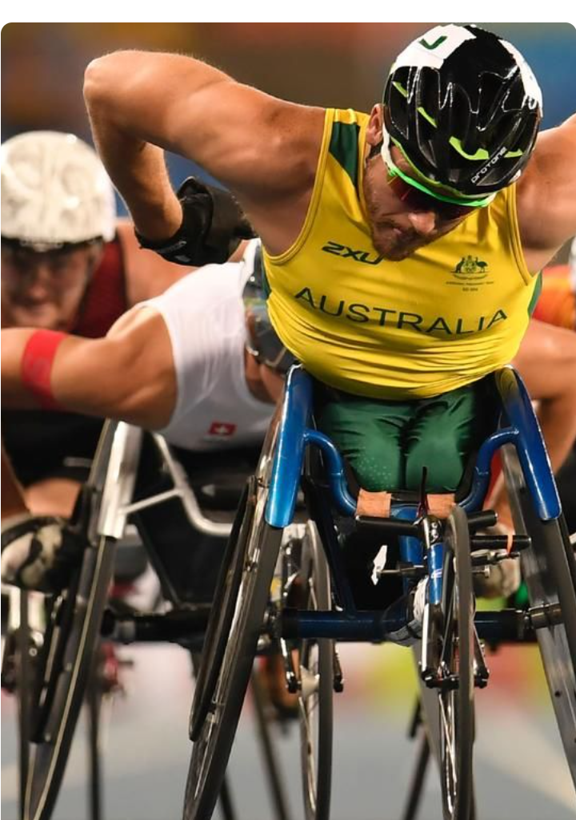
What is Beyond Sport?
Beyond Sport is a program that supports and empowers Para-athletes across Australia. It provides mentoring, advocacy, peer support, skills building, and helps create meaningful employment opportunities.
The program is designed to support Para-athletes throughout their sporting careers and beyond. It draws on the experience of both the Mentoring and BEC programs, and aligns to Paralympics Australia's Strategy, Constitution and Objects; HP2032+ 'Win Well' Strategy; Brisbane 2032 Elevate 2042 Strategy; and the IPC 'Change Starts with Sport' 2023-2026 Strategy.
A key focus of Beyond Sport is remunerating Para-athletes to co-design and deliver the Program with Paralympics Australia Stakeholders (including system and corporate partners and employers), ensuring it meets the needs of the community it serves.
COMMERCIAL IN CONFIDENCE
Image: A close-up shot of Australian Paralympic wheelchair racer Kurt Fearnley in a yellow and green uniform, pushing forward with determination during a race. Other competitors are visible in the background.

Slide 3
Program support for Para-athletes throughout the athlete pathway.
Australian Paralympic Team (APT)
Paralympic Australia
Australian Representative Teams – NSO/NSODs
Beyond Sport Transition – AIS x Paralympics Australia
Mastery
NIN/ SIS/ SAS Network Programs
AIS/ ASC Programs inc Transition Program/ Win Well
Beyond Sport Elite - Paralympics Australia
Elite
Pathways/ Talent ID Program - Paralympics Australia
Para Start Strong Program - AIS/ASC
Beyond Sport Pathway - Paralympics Australia
Emerging Talent
The Start Line - Paralympics Australia
Come n Try – NSO/NSOD's Sport Orgs
Schools Program - Paralympics Australia
Foundation

Slide 4
Impact Highlights
Para-athlete Highlights
200+ Para-athletes employed through the program initiatives
Built a talent pool of roles including mentors, accessibility testers and UD consultants
Based on the Mentoring Program endline survey 78% of participants feel more included in their community.
100% of Mentoring participants reported improved engagement skills and life satisfaction
90% say their knowledge of services and support have improved
Employer Highlights
Based on the Building Employer Confidence endline we saw confidence shifts in all impact measures
Major shift - from 20% - 49% when asked if they have recently employed PWD
Positive shifts in 'ease of attracting PWD’
Positive Shift in confidence for ‘effective onboarding’
Positive Shift in the level of knowledge in employing PWD
Image: Sarah Stewart, Australian 3.0-point wheelchair basketball player, leans right in a crossover dribble to evade a defensive player (off-screen).
COMMERCIAL IN CONFIDENCE

Slide 5
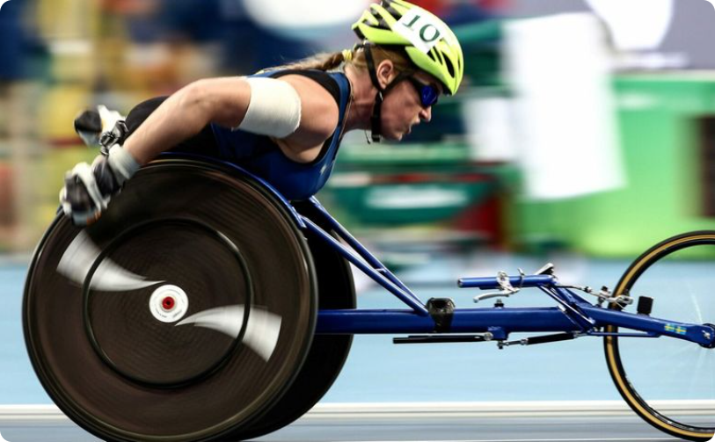
Empowerment Mission
Empowering Athletes
Empower para-athletes to take control of their future, ensuring they have the skills, networks & opportunities they need for a smooth transition into fulfilling careers during, and post, their sport career.
Empowering Employers
Empowering employers with education, resources, and collaborative policy development to build confidence, remove barriers, and support accommodations for inclusive workplaces.
COMMERCIAL IN CONFIDENCE

Slide 6
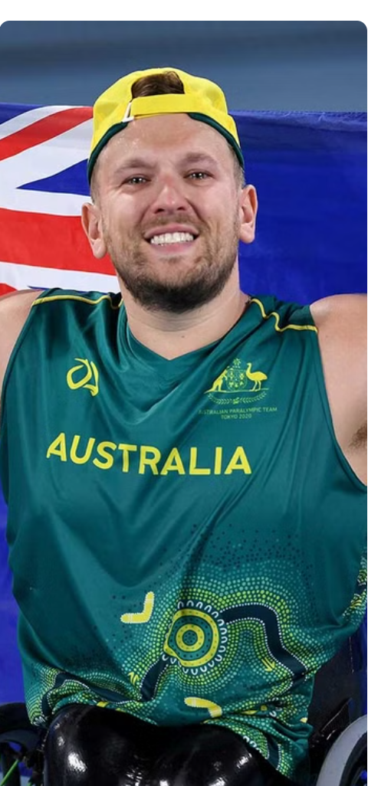
Athlete Program Features
Mentoring & Peer Support
Advocacy
A mutually beneficial mentoring program designed to provide value to both mentors and mentees through a well-structured 8 module program.
The advocacy program is designed to support and promote interests and rights of para-athletes with disabilities, ensuring they have equal opportunities in sports and beyond.
Athlete Employment
Skills Building
Co-designed by PA and Deloitte, our AEP will continue to build on the learnings from the BEC project helping Para-athletes gain meaningful employment creating financial independence.
Integrating a skills-building component into the program enhances its effectiveness by empowering participants with practical tools and knowledge they can apply in their daily lives and their career
Image: Dylan Alcott representing Australia with an Australian flag in the background.
COMMERCIAL IN CONFIDENCE

Slide 7
Employer Program Features
Inclusive Recruitment
Diversity Tools
& Resources
Partner Xchange
Para-Pipeline
Supporting employers in creating workplace diversity, reducing recruitment barriers, and fostering an inclusive culture for sustainable business growth.
Equip employers with a dedicated toolkit to cultivate a diverse and inclusive workplace, enhancing team dynamics and innovation.
Collaborate with employers to profile & place Para-athletes into meaningful, flexible roles, supporting DE&I strategies.
Provide access to Para-athlete talent with the skills & lived experience to service & support employers on their diversity journey, helping shift attitudinal barriers and create inclusive workplaces.
COMMERCIAL IN CONFIDENCE

Slide 8
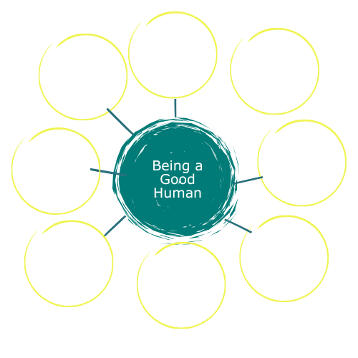
Mentoring Framework
What makes our Paralympian Beyond Sport Mentoring program stand out, is a well-structured series of 8 curriculum modules, that gives the program direction, supports the mentors with content, and allows athletes to reframe goals and challenges and offers constructive support to ‘grow wings’ within a supported program.
COMMERCIAL IN CONFIDENCE

Slide 9
Roadmap
Beyond Sport Program
EOI Launches
(Sept 24)
Recruitment (Sept/Oct 24)
Co-Design
(Oct-Nov 24)
Modules & Insight Sessions Delivered (Nov 24 – July 25)
Program evaluation (Aug – Nov25)
Mentoring program with employment focused modules to build confidence and support athletes
M1 – Goals & Life Balance
Nov/Dec 24
M2 –Building Networks
Dec/Jan 25
M3 – Mental & Physical Health
Feb 25
M4 –Financial Literacy
March 25
M5–Career, Education & Leadership
April 25
M6 –Building your Brand
May 25
M7 – Fit for Life
June 25
M8 –
Become an Entrepreneur
July 25
Target 5 Partner Xchange – work with key partners on profiling, recruitment and onboarding process
Meet with top 5 partners (Nov)
In principle agreements (Nov/Dec)
Employment process mapping (Jan-Feb)
Placement opps (March +)
Employment Networking Sessions – Partners and athletes engage in a structured virtual forum in partnership with ASC/AIS
Session planning (Oct)
Develop partner presentations (Nov+)
Deliver Sessions (Dec+)

Slide 10
Paralympics Australia Corporate Partners Involved
System Stakeholders & Employers involved
Archery
Snow Sport Australia
Boccia
Wheelchair Rugby
Blind Sport Australia
PA Teams and Staff
VIS & QAS
Table Tennis
Centre for Universal Design Australia
Ellis Jones
MGAC and Jenson Hughes
Kaunergrat Nature Park
Orima Research
NSW Government
Essendon Hangar
COMMERCIAL IN CONFIDENCE

Slide 11
Join us in helping shape our para-athletes of tomorrow.
You can join us:
By supporting and promoting the Beyond Sport program – submit an EOI for yourself and share details with our mob - to be a mentor, be a mentee, help us with co-design, to be kept in the loop for job opportunities, etc.
By recommending Beyond Sport to para-athletes who you know are struggling with things, such as:
Defining life goals
Understanding their next career move
Those unsure where to get services or support
Those who need help with their transition – into HP sport, on to Games teams, into leadership, transferring between sports, into education, into part-time or full-time work around sport, into their long-term career, retiring, etc.
Check out our website: https://www.paralympic.org.au/community/programs/beyond-sport-mentoring-program/
EOI: https://forms.gle/MVQJQsqzoUqZF1mp7
Thank you.

